Slide 1

https://media.sweetwater.com/m/insync/2018/08/keyboardexpression.jpg
Adapter For Expression Pedals
Amon Benson | Sensor and Actuator Systems | Final Presentation | 28. September 2026

Slide 2
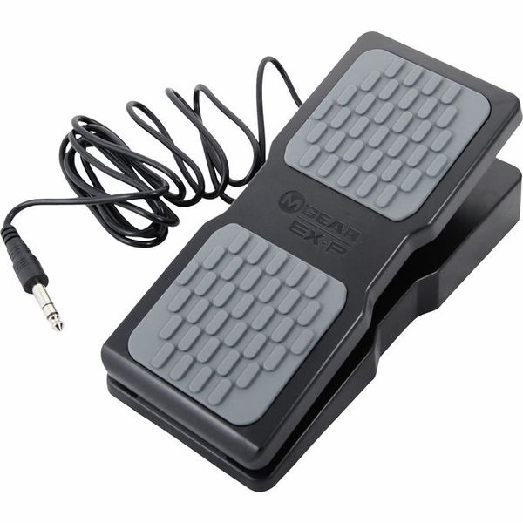
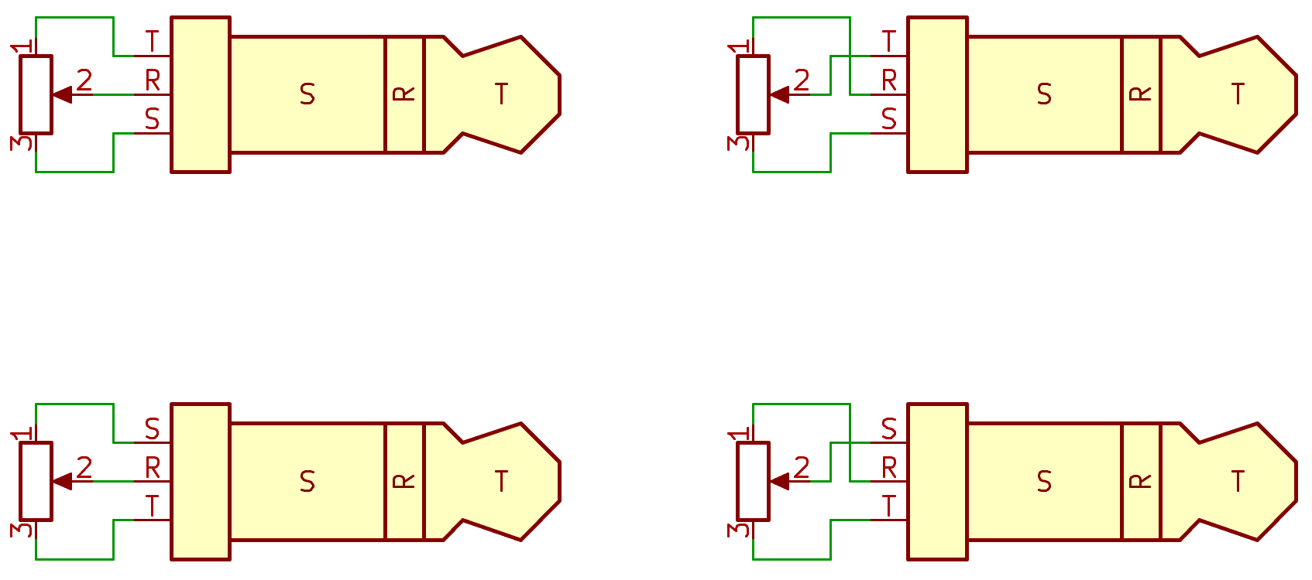
Recap
https://thumbs.static-thomann.de/thumb/padthumb600x600/pics/bdb/_19/195660/7223134_800.jpg
Notes:
Expression Pedal = Potentiometer that can be controlled by a footpedal
Used mainly in live audio
Complexity comes from the fact that no standard pinout exists
Device to detect and support all possible pinouts and resistance values
→ The device needs to
detect the specific configuration of an attached pedal
continously read its position and send that to the host PC via the MIDI-USB protocol

Slide 3
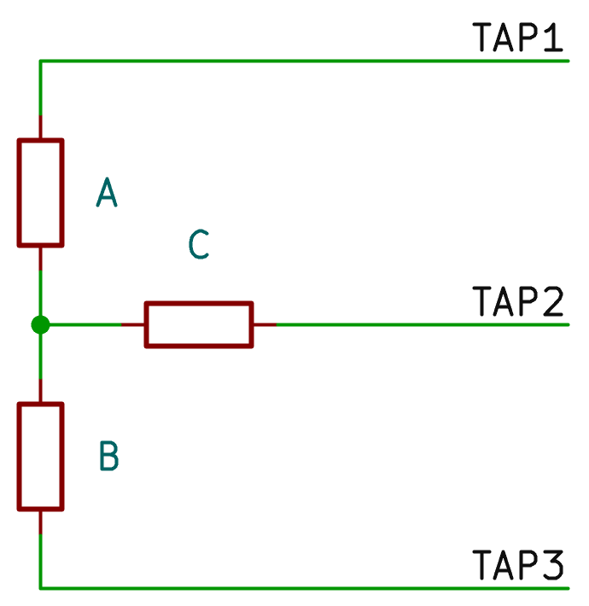
Detection Process
Notes:
If this general model of 3 resistors is a potentiometer, one of the resistors must be 0 Ohm, while the others form the voltage divider
By measuring which resistor is 0 Ohm, we know which pin is the wiper

Slide 4
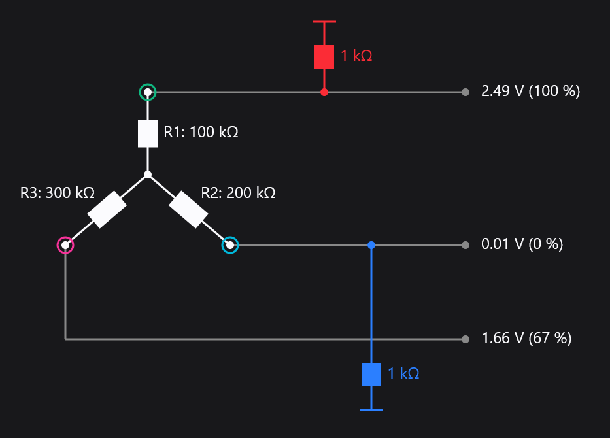
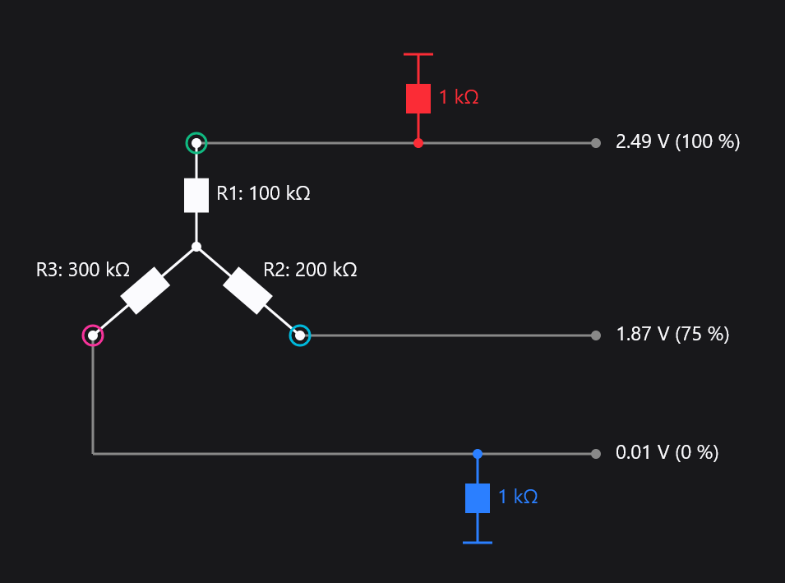
Detection Process

Slide 5
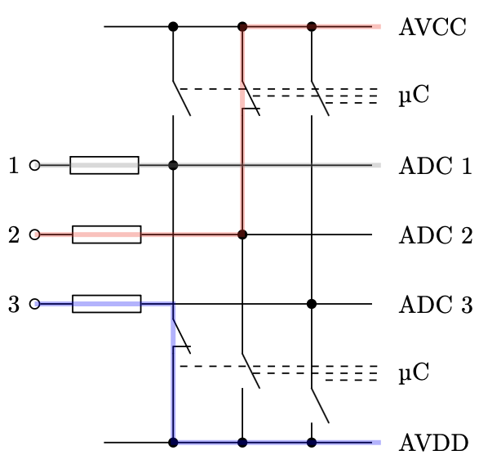
Detection Process
+3.3V
Tap 1
Tap 2
Tap 3
GND
Notes:
Each Tap can be pulled High, Low, or left floating
Each Tap is connected to a separate ADC channel
Live Demo

Slide 6
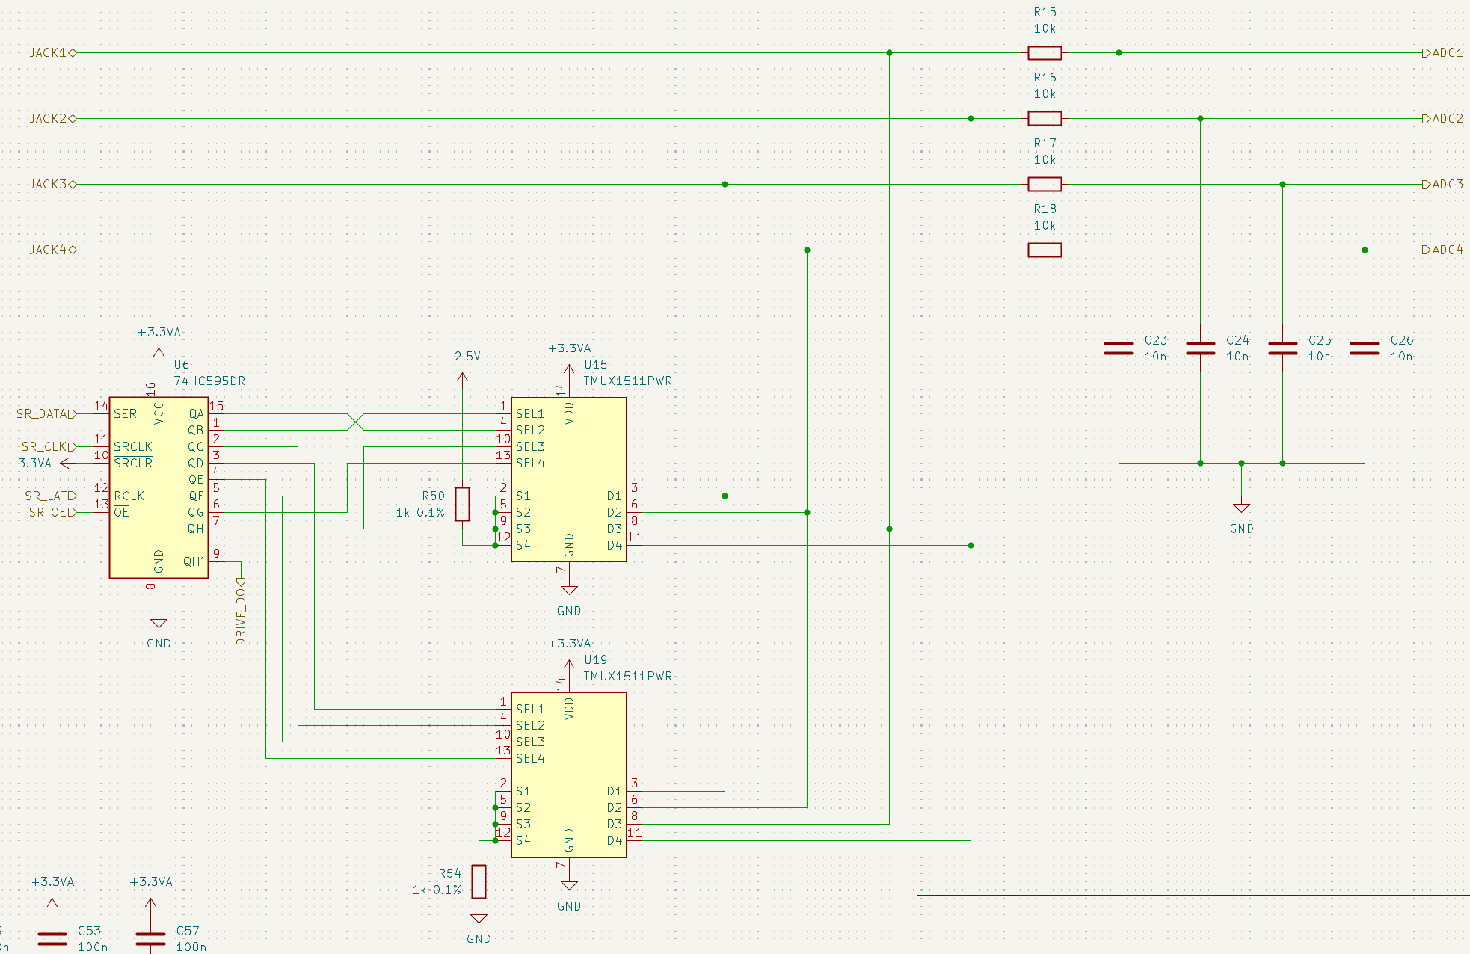
Differences to Milestone 1 Schematics

Slide 7
Sources
[1] M. Frejek, "AVR-Transistortester," Embedded Projects Journal, no. 11, 2011. Online documentation: K.-H. Kübbeler. [Online]. Available: https://www.mikrocontroller.net/articles/AVR-Transistortester
[2] Mission Engineering, "Understanding expression pedals." [Online]. Available: https://missionengineering.com/understanding-expression-pedals/
[3] Analog Devices, AD7124-8: 8-Channel, Low Noise, Low Power, 24-Bit, Sigma-Delta ADC with PGA and Reference, Data Sheet, Rev. F, 2023. [Online]. Available: https://www.analog.com/media/en/technical-documentation/data-sheets/ad7124-8.pdf
[4] Texas Instruments, ADS8688: 16-Bit, 8-Channel, Integrated Analog Front-End SAR ADC, Data Sheet. [Online]. Available: https://www.ti.com/product/ADS8688
[5] Raspberry Pi Ltd., Raspberry Pi Pico 2 Datasheet (RP2350), 2024. [Online]. Available: https://pip-assets.raspberrypi.com/categories/1005-raspberry-pi-pico-2/documents/RP-008299-DS-2-pico-2-datasheet.pdf
[6] Texas Instruments, SN74LVC126A: Quadruple Bus Buffer Gate With 3-State Outputs, Data Sheet. [Online]. Available: https://www.ti.com/lit/ds/symlink/sn74lvc126a.pdf
[7] Analog Devices, ADP7142: 40 V, 200 mA, Low Noise, CMOS LDO Linear Regulator, Data Sheet, Rev. K. [Online]. Available: https://www.analog.com/media/en/technical-documentation/data-sheets/adp7142.pdf
[8] P. Horowitz and W. Hill, The Art of Electronics, 3rd ed. Cambridge, U.K.: Cambridge University Press, 2015.
[9] W. Kester, J. Bryant, and M. Byrne, "MT-031 Tutorial: Grounding Data Converters and Solving the Mystery of 'AGND' and 'DGND'," Analog Devices, Rev. A, 2008.

Slide 8
Testing and Evaluation Plan
power supply quality
SPI signal quality
functional self-test
  SPI device inquiry (ADC)
  tristate buffer
detection algorithm for known static networks
accuracy and linearity
end-to-end latency
Notes:
Measure voltage and SNR on the supply rails
Measure signal integrity of the SPI bus
Self-tests: SPI device id inquiry, tristate buffer pullup/pulldown using ADC
Detection algorithm for known networks
Apply a resistor configuration and validate the detected topology
Also apply edge cases where R=0 Ohm (short or open circuit)
Sweep a precision resistor and compare the measured resistor ratio to the actual one
Measure end-to-end latency from input resistance change to the value arriving at the USB host

Slide 9
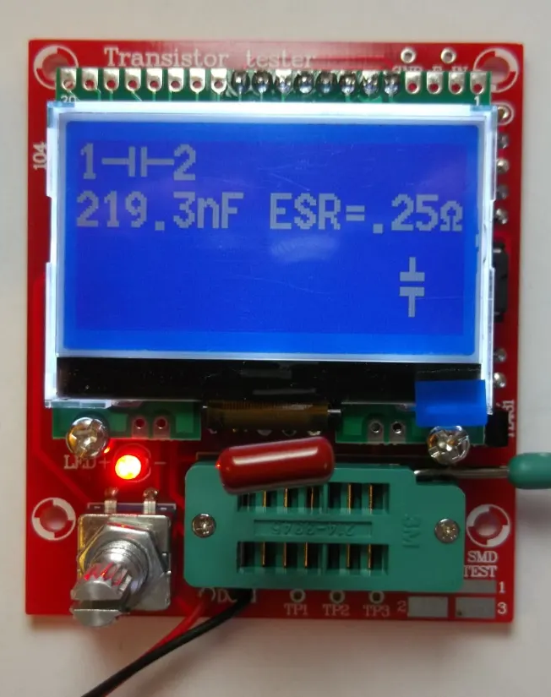
“AVR-Transistortester”
https://content.instructables.com/F4V/9O1Y/IFCDEPNY/F4V9O1YIFCDEPNY.jpg
Notes:
Similar principle: “Transistor tester”

Slide 10
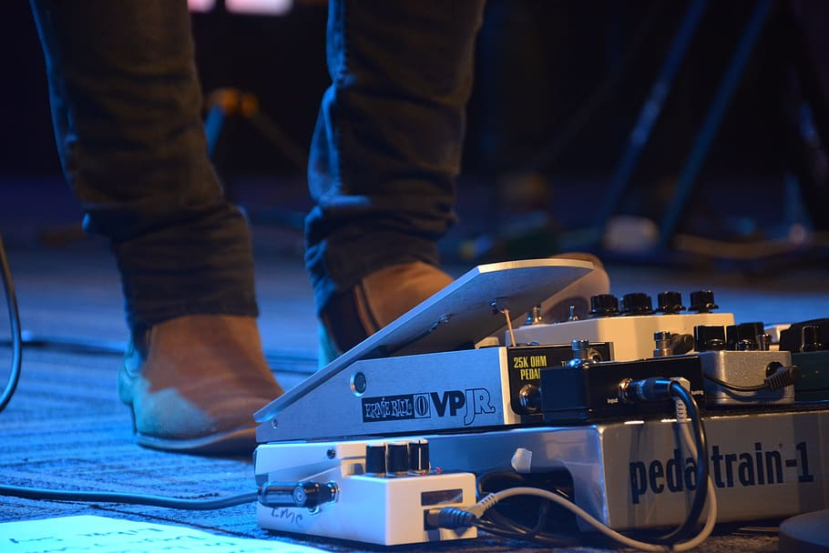
Recap
https://media.sweetwater.com/m/insync/2018/08/keyboardexpression.jpg
https://thumbs.static-thomann.de/thumb/padthumb600x600/pics/bdb/_19/195660/7223134_800.jpg
Notes:
Expression (sometime Volume) Pedals are used during live performances to alter the sound of an audio signal
Example image: guitarist, can apply audio filter/modify frequence with both hands free
Compared to a switch pedal: Set a specific position and drive continuous values
Goal of this project: Create a hardware adapter to connect these pedals to a PC

Slide 11
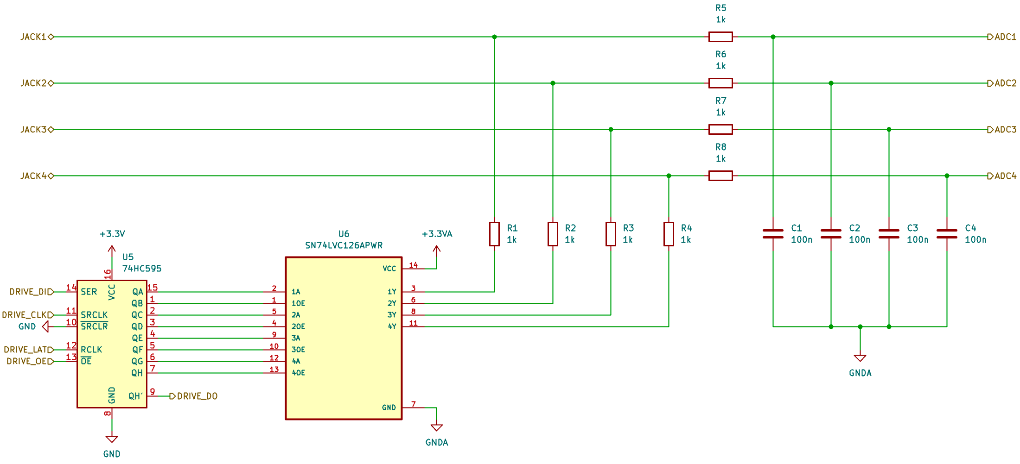
Circuit Design – Analog Frontend
Tap 1
Tap 2
Tap 3
(unused)
Notes:
Pullup/down: Tristate Buffer IC (SN74)
Two control signals per output → 74HC shift register (Microcontroller GPIO expansion)

Slide 12
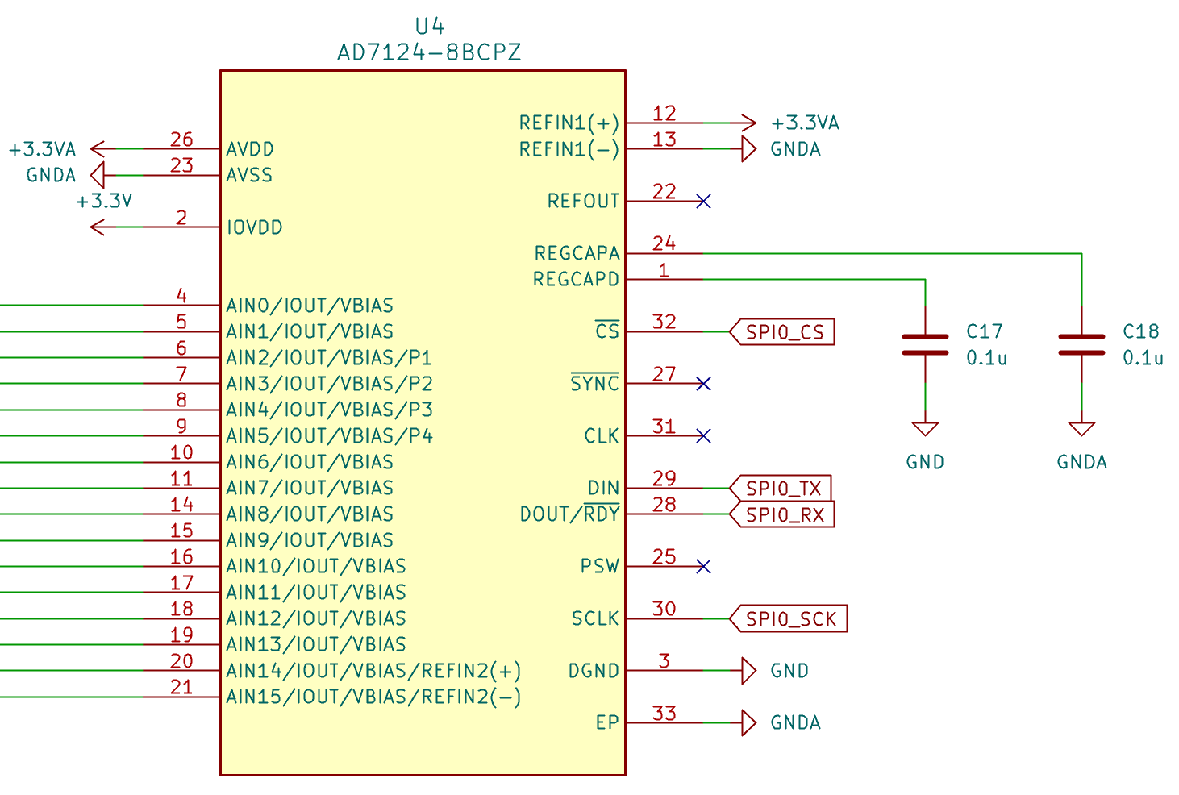
Circuit Design – ADC
ADC 1.1
ADC 1.2
ADC 1.3
ADC 1.4
ADC 2.1
ADC 2.2
…
Notes:
ADC: AD7124
Low speed (< 1kHz) → Sigma Delta
Works with 3.3V supply (Microcontroller logic level)
Interface via SPI
Minimal external circuitry required

Slide 13
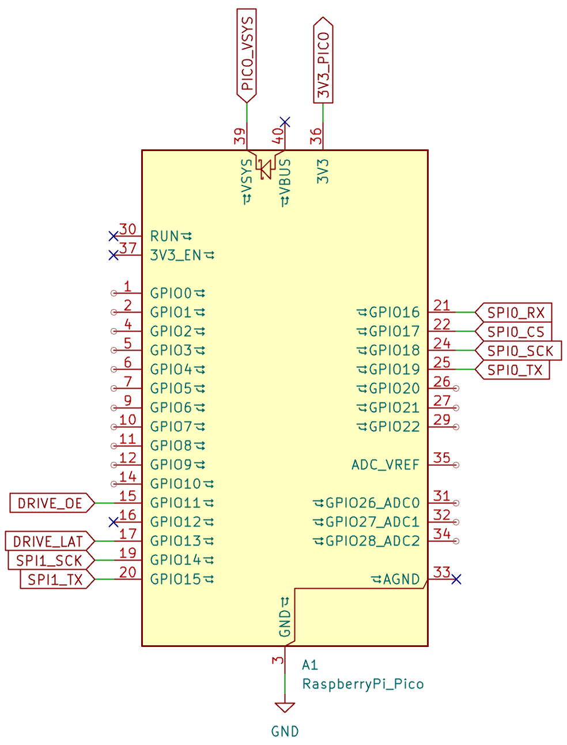
Circuit Design – Microcontroller
Notes:
uC: Raspberry Pi Pico 2 Module
Bare RP2040 chip → USB, crystal, flash, etc. would all need to be added manually. Pico 2 Module is the official (well tested hardware)
STM32 (F4/G4/L4) → Faster CPU, but more external hardware required + proprietary USB stack

Slide 14
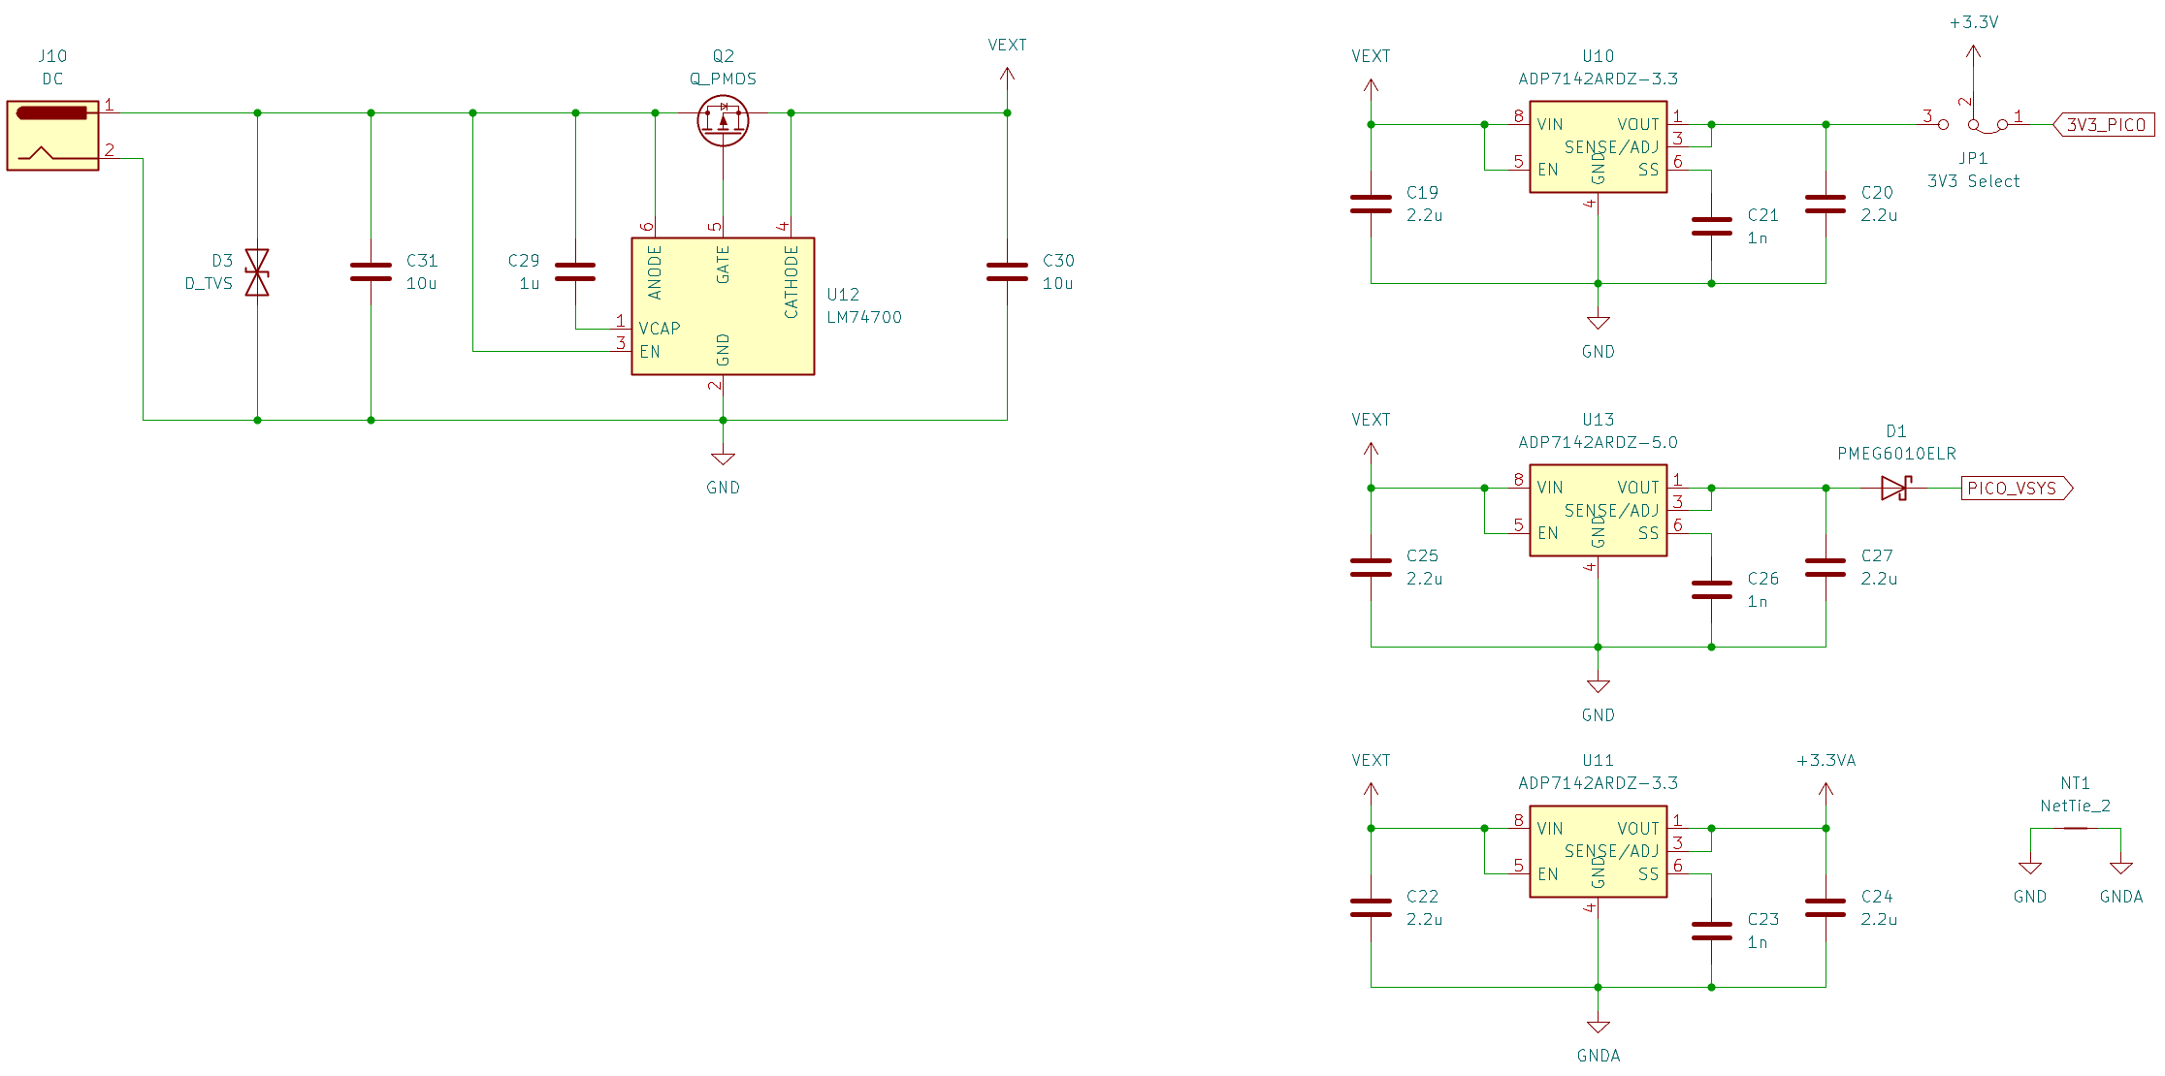
Circuit Design – Power Supply
Digital Supply (3.3V)
Analog Supply (3.3V)
Digital Supply (5V)
Notes:
Digital supplies (5V and 3.3V)
3.3V can be toggled between this LDO and the Pico Module’s onboard voltage regulator
Analog supply
GND connected via single star point

Slide 15
Circuit Design – DC Input Protection
Notes:
Reverse polarity protection circuit via an ideal diode
TVS protection diode for voltage spikes

